Slide 1


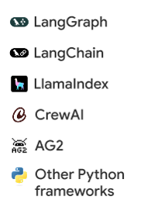

Self Improving Agent Workflow
Agent Frameworks
Agent Engine
Example Store
Vertex AI Prompt Optimizer
Vertex AI Prompt Optimizer
Vertex AI Evaluation
Optimized Prompt Template
Original Prompt Template
Optimization Settings
Target Model
Evaluation Metrics
Optimization Mode
Cloud Tracing
Cloud Logging
Cloud Monitoring

